Slide 1
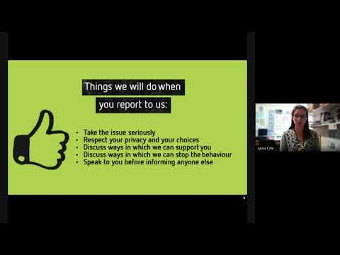
https://www.youtube.com/watch?v=lsh3aQFhUVE

Slide 2

Headstrong
Week 6
Step up, Speak up!

Slide 3

















Banter
or
harassment?
Where’s the line?
A Campaign Toolkit from
Notes:
Placeholder slide whilst students enter the room.
Please see the Project deSHAME “Step Up, Speak Up!” Assembly Guidance notes for further delivery information.

Slide 4

















What is life online like for you?
Notes:
• What do you like to do online?
• What apps and services do you use?
• What are your favourite things about being online?
• Are there any negative aspects of being online?
Explain to students that as a school you want to support your students with all the positive aspects of being online, but you also know that there can be negative aspects to life online as well, and some of these may be issues like bullying and harassment. Confirm that as a school you’re committed to tackling bullying and harassment in all its forms including when it takes place online. Explain that the session is going to focus on a particular form of online harassment.

Slide 5















posts
“He blackmailed me and said, that if I didn’t send more pictures he would send my nude to all of his friends and to the people at my school.”
“I have experienced lots of homophobic comments after coming out”
comments
“Someone had recorded her during sex and then
had gone around showing it to some of his friends.”
“Someone made a fake account of my friend, and has been commenting mean things on other people’s photos.”
likes
pages
images
“You send something to this profile... gossip, right, and then they make a post about it.”
“Everyone was screenshotting it and posted it to their stories saying ‘slut’ or ‘slag’...”
“Apparently I sent a nude to a girl in my year, but this was from a fake account with a picture from the internet.”
“I got a message from a boy from my school. It was pornography...”
videos
messages
Notes:
Explain that these are real life examples which were described during research into online sexual harassment – the topic for today’s session.

Slide 6

What is online sexual harassment?
Any unwanted sexual behaviour that occurs online.
It happens in many forms across many services and could be public or private.
Notes:
Online sexual harassment can be defined as unwanted sexual behaviour on any digital platform. It can happen to anyone online, but this assembly (and the whole Step Up, Speak Up toolkit) specifically focuses on peer-to-peer online sexual harassment.
Online sexual harassment can include a wide range of behaviours that use digital content (images, videos, posts, messages, pages) on a variety of different online platforms (private or public).

Slide 7






Where does it happen?
Who
does it happen to?
Notes:
Read aloud the first question.
Explain that there is no typical victim of online sexual harassment. It can impact both boys and girls, although research shows girls are more likely to face harsher consequences if they are targeted.
Next, explain that online sexual harassment often overlaps with other discrimination and hate crimes, online and offline. It often overlaps with harassment related to a person’s actual or perceived gender, sexual orientation, race,
religion, special educational needs or disability.
Read aloud the second question.
Explain that online sexual harassment by definition takes place online, but that it’s important to remember that it impacts the offline world too. It’s often playing out in front of a school or local community audience.

Slide 8
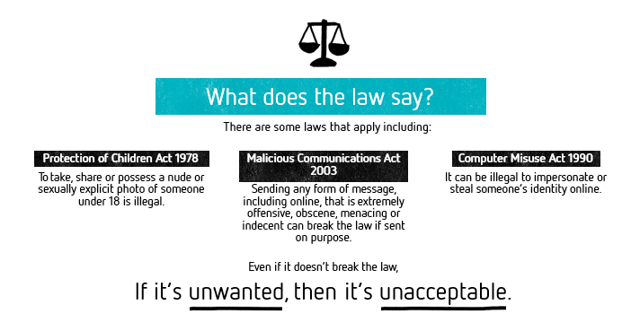

Slide 9


One of Rani’s close friends, Sam, is behaving oddly. They are unusually quiet and Rani thinks they might have been crying.
At break time all Rani’s classmates are excluding Sam but nobody will tell Rani why.
In the afternoon Rani receives a nude image of Sam from a classmate who jokes about it and tells Rani “share it on – it’s what they deserve…”
What would you do?
Send it on. They took the photo in the first place so they had this coming.
Do nothing. Don’t get involved.
Don’t share the photo but avoid the friend. You can’t believe they’d do something like this.
Speak up. Support the friend and let their classmates know that sharing this kind of thing is wrong.
Notes:
Most helpful response: D

Slide 10


It’s clear Sam didn’t want their photo shared on like this. They’re unhappy and not only has their image been sent on, but they’re now
being excluded and bullied because of it.
Sharing the image on breaks the law and is unacceptable, but
standing by and doing nothing won’t help either.
Sam needs a friend they can rely on. Rani could be that friend.
Offering your support and your friendship can make a real difference when someone feels alone.
Notes:
Feedback the response to the scenario, with input from students where appropriate.
Consider asking students how they think being a victim of online sexual harassment might make someone feel. Take responses if appropriate. Use the students’ responses to lead in to the next slide.

Slide 11
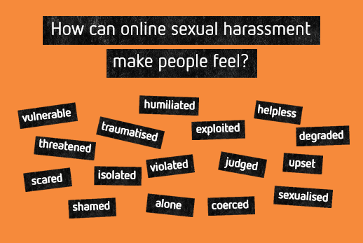

Slide 12
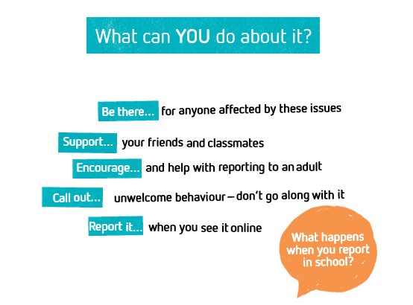

Slide 13
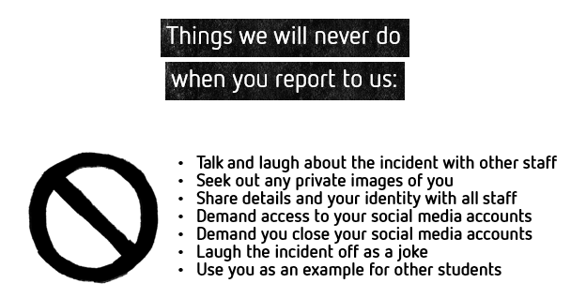

Slide 14

Notes:
Explain that as staff members you have strict rules and guidelines on how to respond when things are reported to you.
Tell the students that on the next slide they’ll get to hear what those rules say and how school will deal with reports that are made to them.
Reassure them again that as staff members you want to help and support them and then read the points on the slide, expanding where necessary.
For example, you may want to clarify that although you will speak with them before informing anyone else, there are some cases where you have a legal responsibility to involve the police or other external agencies.

Slide 15


You can report online sexual harassment to any member of staff in school
We will listen and take it seriously
We will offer support and guidance to help you move forward
We will respect your privacy but may have to share what you’ve told us with one of the DSL team
Mrs Manning
Mrs Batt-Corcoran
Mrs Cole
Mrs Cooper
Mr Crowther
Mrs Hone
Mrs Mills
Mrs Rowe
Notes:
Explain to students that you’re nearing the end of the session and that you hope they’re feeling more confident about how and why they should report online sexual harassment. Remind them that as a school you’re committed to taking online sexual harassment seriously and to responding to any report that is made.
Use this opportunity to remind them of any key points in your reporting procedures and to identify your school or setting’s DSL (Designated Safeguarding Lead). Explain that the DSL has authority for dealing with reports of online sexual harassment, so other staff members may need to share what they have been told with them. You could also use this opportunity to explain where the DSL can be found – for example, where their office is or what times they are available to speak with students.

Slide 16
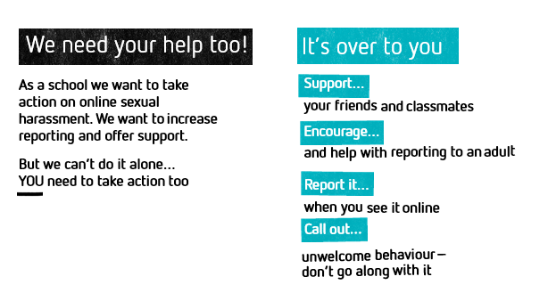

Slide 17

Step up, Speak up challenge...
Your challenge this week may not actually need to happen for a while, however, as a form, you need to make a pledge that you will speak up if you know that sexual harassment has taken place.
Make sure you are report it, support your friends and are prepared to call it out if you think something should not be happening!

Slide 18


Slide 19











0808 808 4994
Digital Exploitation and Sexual Harassment Among Minors in Europe Understanding, Preventing, Responding
Co-financed by
the European Union
Notes:
Draw attention to the slogan: Step up, speak up and put an end to online sexual harassment.

