Slide 1
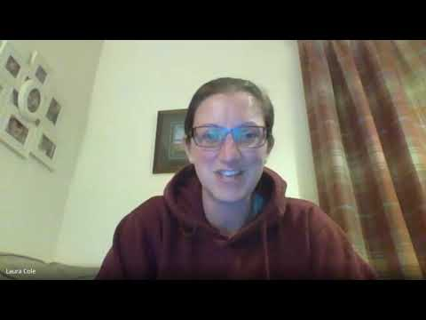
https://www.youtube.com/watch?v=aZnbFKBvKRU

Slide 2

Headstrong
Week 5
World Mental Health Day
10th October

Slide 3
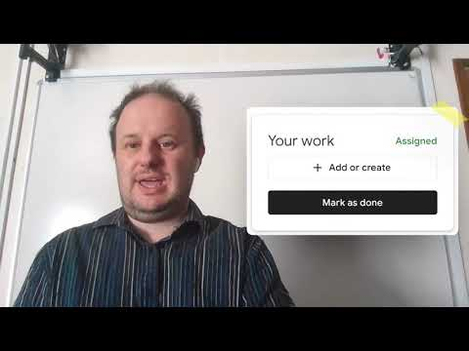
Clip to watch if you haven’t already seen Mr Jackson’s film about use of google: https://youtu.be/4cZWgYJQFjo

Slide 4


Why might this be the theme of world mental health day 2021?
Which aspects might be unequal?
Why?

Slide 5


Slide 6

There are 2 options for your challenge this week depending on which film you need to watch:
Make sure you look at your google classroom and follow Mr Jackson’s instructions to keep you in control of your work.
OR
Discuss as a form why you think mental health support is unequal around the world. What do you think is the most important message around mental health that we should share on 10th October to mark World Mental Health Day? Who could you talk to outside of school about mental health to share that message?

Slide 7


