Slide 1

l

Slide 2

SGLI
TUTOR
TIME
TALKS

Slide 3

SGLI Project
Encouraging discussions and connections
Bringing awareness to the things going on around us
Having fun together!

Slide 4
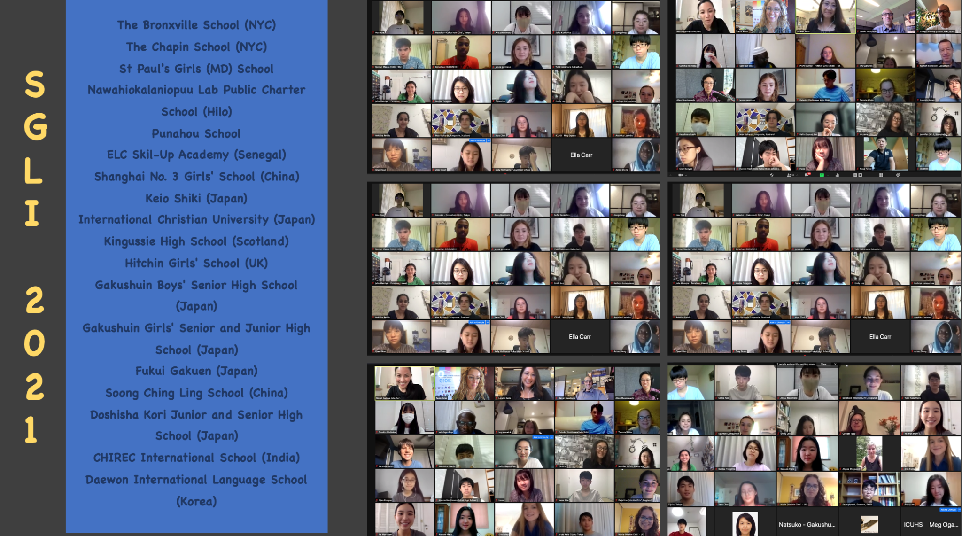

Slide 5

Your challenge this week is to complete the four corners debate during registration this morning.
You get points for everyone who joins in this challenge!

Slide 6
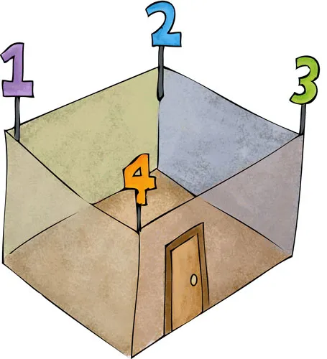
Four Corners Activity
1 Strongly agree
2 Agree
3 Disagree
4 Strongly disagree

Slide 7

International Day of Non-violence

Slide 8


“Violent video games should be banned”
Strongly agree
Agree
Disagree
Strongly disagree

Slide 9
“War is never justified”
Strongly agree
Agree
Disagree
Strongly disagree

Slide 10

World Farm Animals Day

Slide 11
“Animals should have the same rights as humans”
Strongly agree
Agree
Disagree
Strongly disagree

Slide 12

Techies Day

Slide 13
“Artificial intelligence is dangerous”
Strongly agree
Agree
Disagree
Strongly disagree

Slide 14


Slide 15


