Slide 1
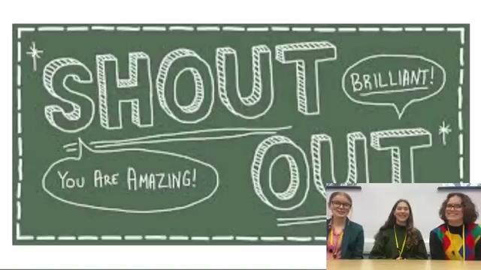
Notes:
Link to youtube video that you’re asked to watch: https://youtu.be/bI1OXWIQf3k

Slide 2
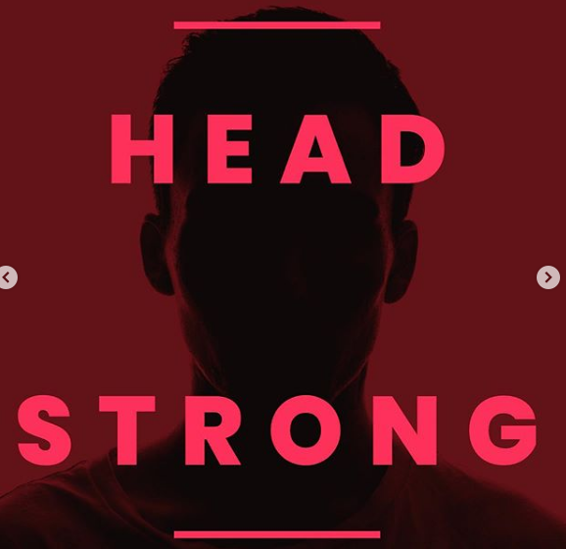
SGLI
TUTOR
TIME
TALKS

Slide 3


Slide 4
Pause to watch this video
https://youtu.be/bI1OXWIQf3k
Notes:
Resume main video at 0:23

Slide 5
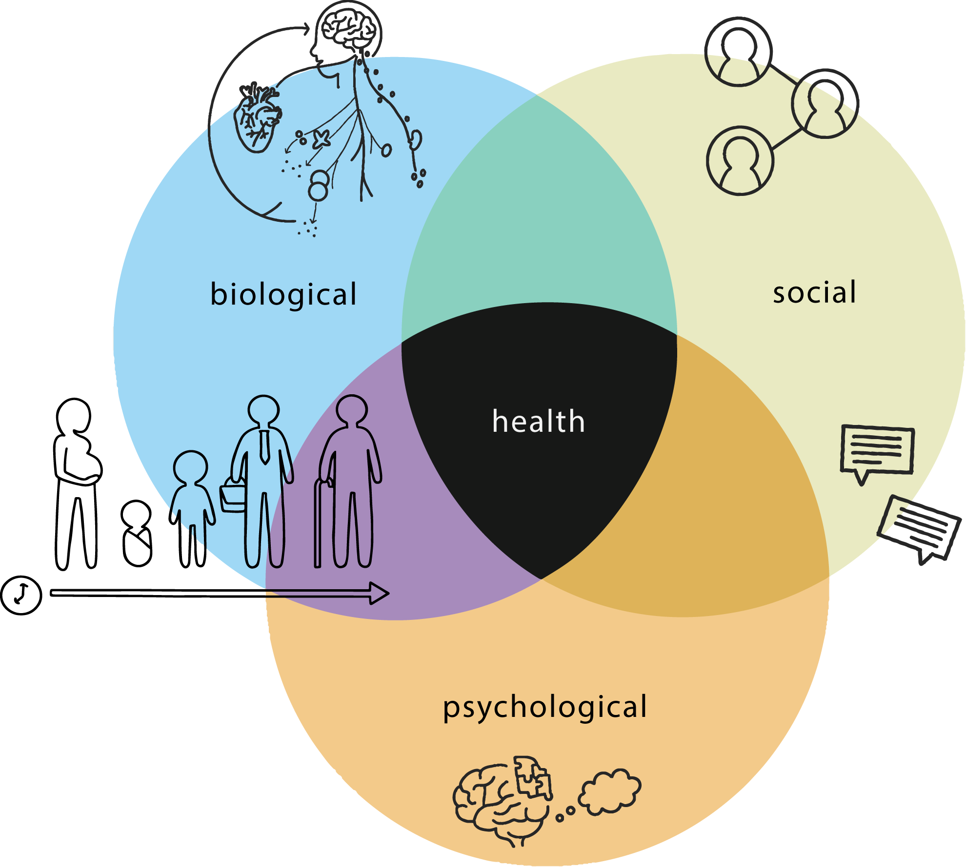
Notes:
being physically well

Slide 6

Create an annotated picture to show what health means to you
You’ll get points for every annotated stick person that’s created

Slide 7
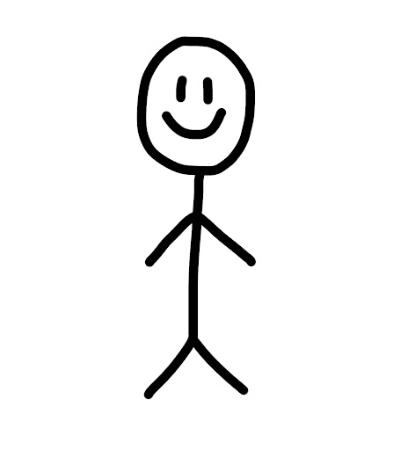
Create a healthy stick person!
Getting enough sleep
Having a positive attitude

Slide 8
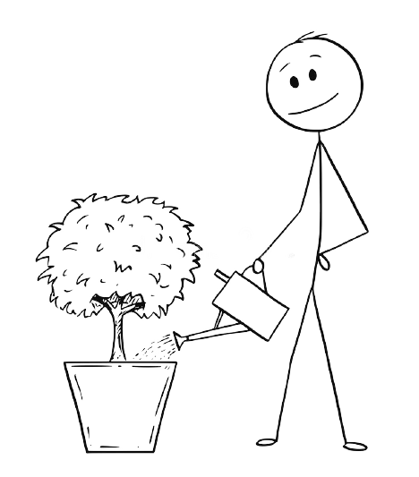
You could even put your stick figure in a healthy environment!
Nurturing other people/thing’s health
Spending time outside

Slide 9
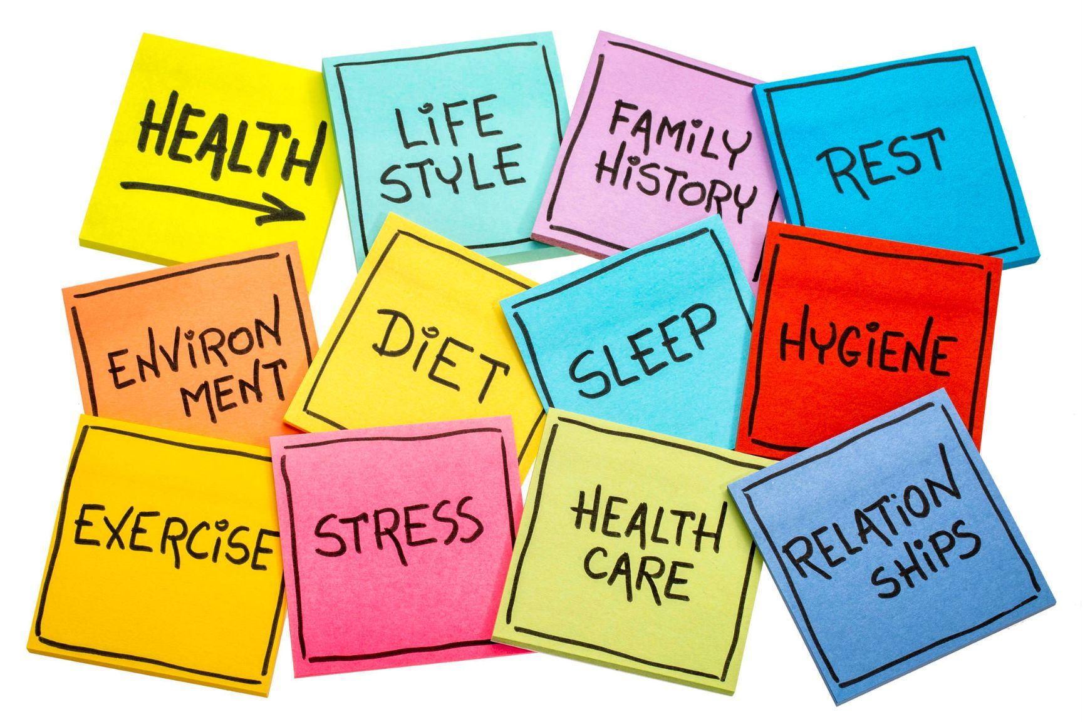
Here are some ideas to get you thinking:

Slide 10


