Slide 1


Headstrong

Slide 2
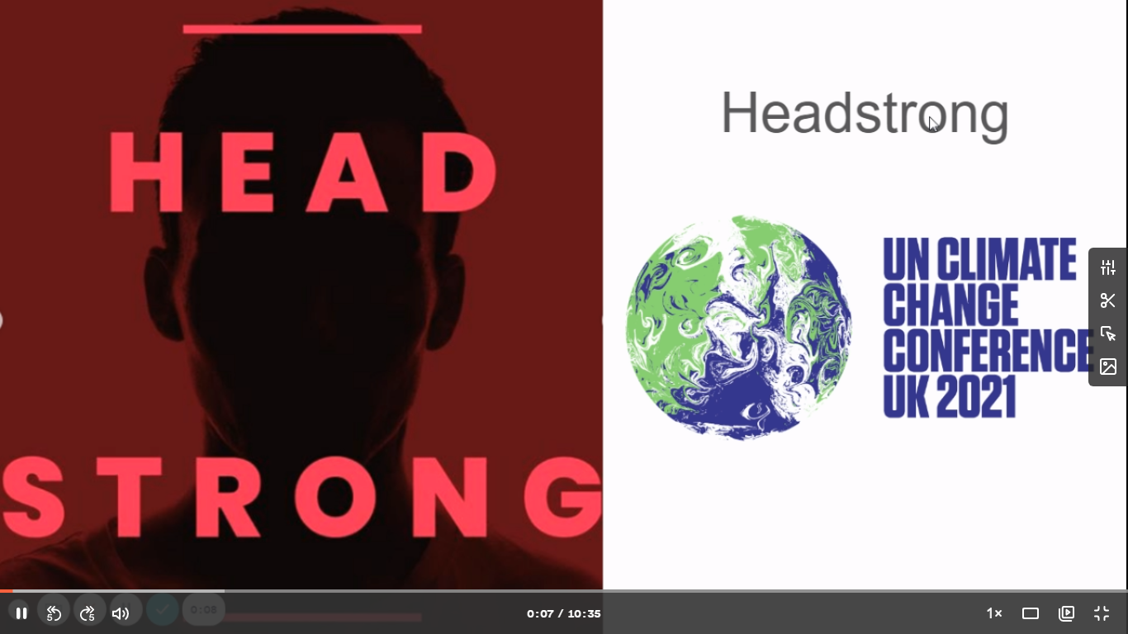
https://www.loom.com/share/17ae24b29a4044809dba70a155675b16

Slide 3


COP26
What is COP26?

Slide 4
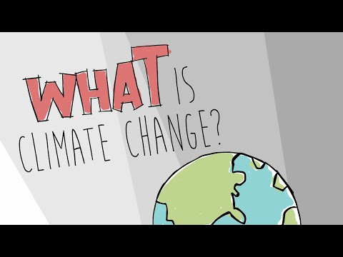
COP26
What is Climate Change?
Climate change is the change in our climate as a result of global warming, which is caused by an increase in Carbon Dioxide in our atmosphere.

Slide 5
COP26
Average global temperatures have increased by 1.2°C since 1850
So what?
This seemingly small increase in temperature has resulted
in serious climate change with impacts such as:
Melting Ice in Antarctica and sea-level rise | Intense heat waves, drought and famine | Increased storms and flooding | Loss of biodiversity and extinctions | Increased wildfires including in Siberia

Slide 6
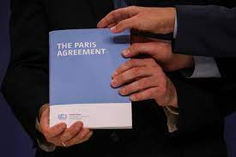
COP26
Why do we need COP26?
One of the main goals of COP26 is to review the targets set at COP21 in Paris in 2015 where all the countries present agreed to prevent global temperatures from warming by more than 2°C, and try to keep the increase as low as 1.5°C.

Slide 7
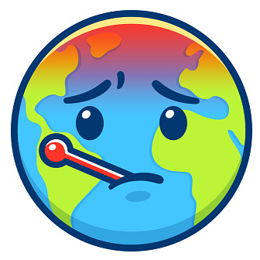
COP26
Why is 1.5°C warming so important?
Limiting temperature rise to 1.5°C could:
Reduce the number of people exposed to climate-related risks by several hundred million
Reduce pressure on food security and human health
Better protect small island states from sea level rise
Cut extinction rates and preserve some coral reefs
Reduce the risk of irreversible polar ice sheet melt

Slide 8




COP26
What will happen at COP26?
Leaders from 200 countries will review progress made since COP21 in Paris (2015)
They will then make new decisions on how to cut carbon dioxide emissions.
The rich countries will review their pledge to provide financial assistance to poorer countries ($100 bn)
Many people believe that COP26 is our last chance to stop a climate catastrophe

Slide 9
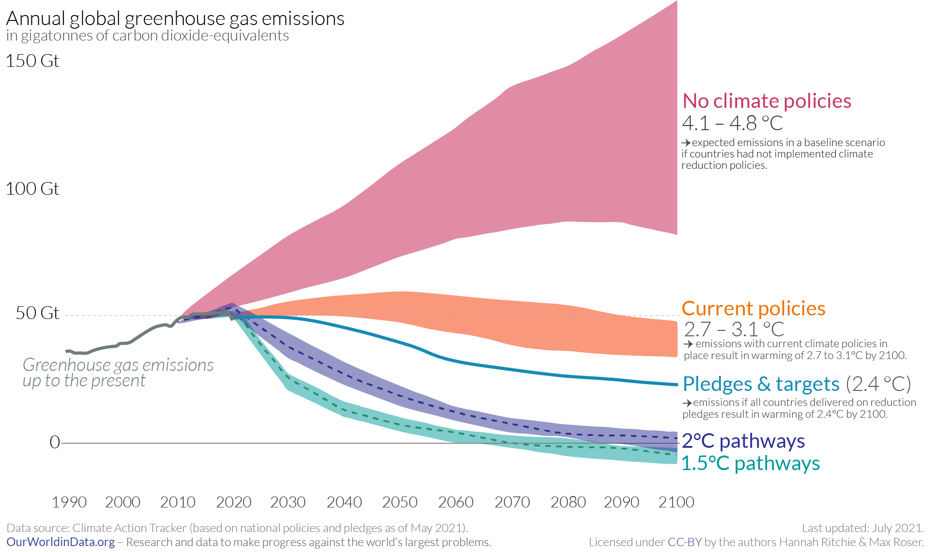
COP26
So, how are we doing?
Remember the Paris Agreement was to keep Global Warming below 2°C by the year 2100.
Target: What we say we will do
Policy: What are are actually doing
Current policies means warming will be 2.7-3.1°C
Current targets means warming will be at least 2.4°C
We are NOT on track to meet the Paris Agreement of 2°C

Slide 10

COP26
As we have just seen, we are not on track to meet the less than 2°C warming set in Paris. If we want to avoid a Climate Catastrophe then the leaders at COP26 will need to make some big decisions and changes to policies.
Decisions which could affect our jobs, how we heat our homes, what we eat and how we travel.
The UK, has set a target for all of the nation's electricity to come from clean sources by 2035

Slide 11

Complete the COP26 class quiz as a form.
Watch the daily COP26 updates from the Royal Meteorological Society.
Calculate your own carbon footprint.
Make a #PromiseToThePlanet by making a climate friendly change to your lifestyle. Can you keep it up?

Slide 12


