Slide 1
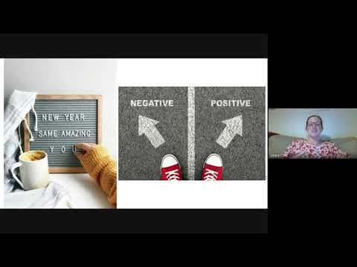
https://www.youtube.com/watch?v=L5iTE45JE30

Slide 2


Headstrong
Week 14

Slide 3

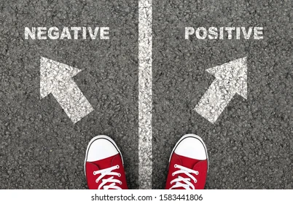

Slide 4
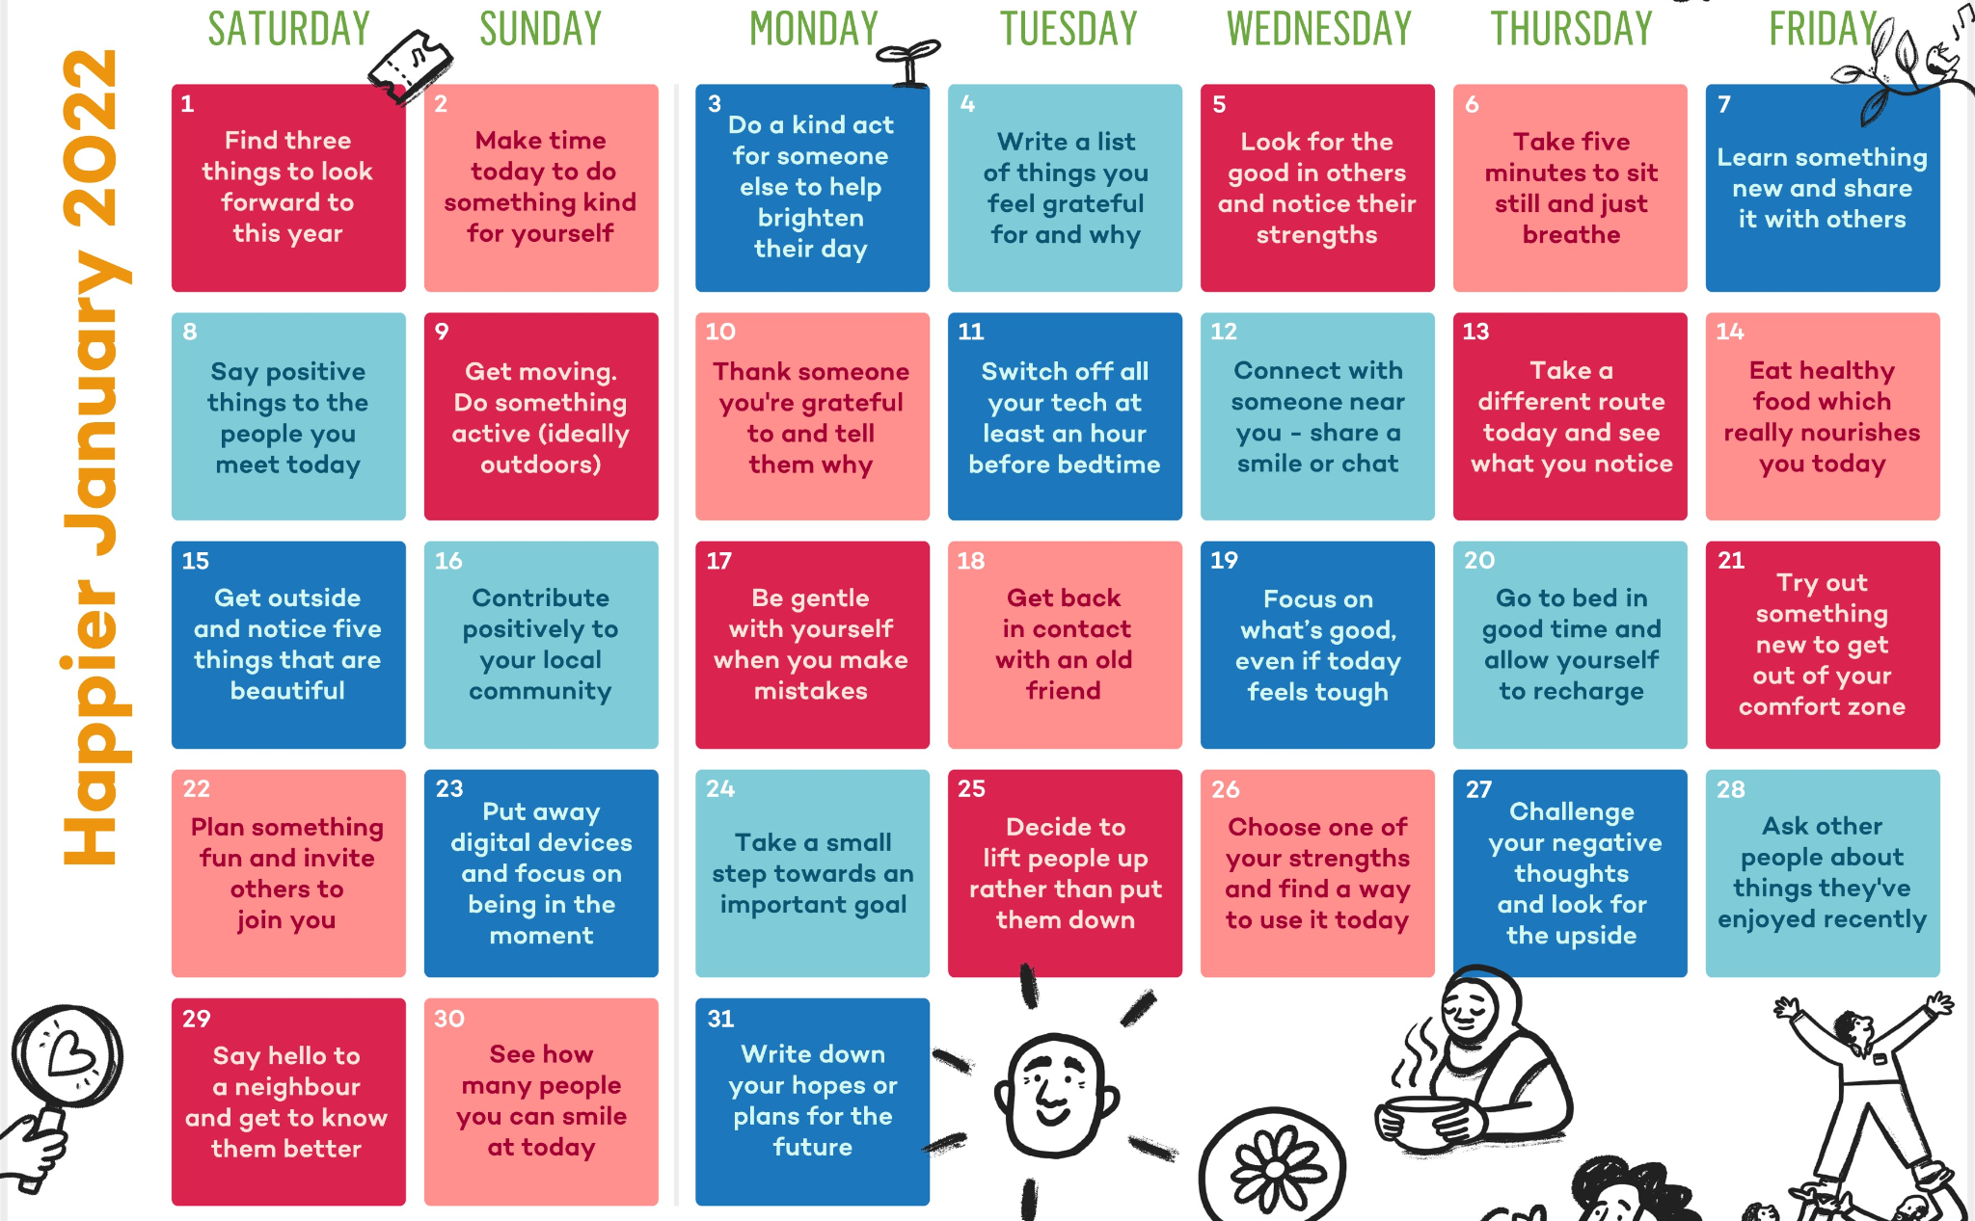

Slide 5

Happier January…
As a form, you will pledge to complete at least 1 challenge each from the Action for Happiness calendar for January. You can choose to complete more challenges as a bonus if you would like to.
Remember that feeling happier is often about thinking happier first!

Slide 6


