Slide 1
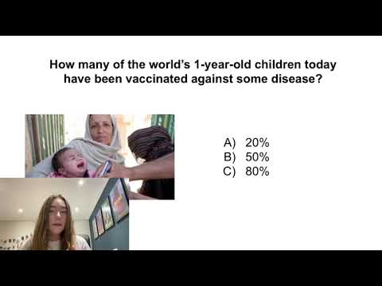

Slide 2

SGLI Tutor Time Talks
Factfulness

Slide 3


Answer the Factfulness Quiz with your
form to learn about your worldview
Notes:
This week your challenge is to carry out a quiz , called the factfulness quiz, that we are going to talk you through. It's not a quiz in a typical competitive sense but it is more about checking your knowledge and what your viewpoint is. The answers are multiple choice so please discuss the questions with your whole form to try to come up with the answer which you think is the most appropriate. We will explain why we asked you to do this quiz at the end!!

Slide 4

In all low-income countries across the world today, how many girls finish primary school?
20%
40%
60%
Notes:
pause the video while you discuss your answer!

Slide 5
In all low-income countries across the world today, how many girls finish primary school?
20%
40%
60%
Notes:
c) 60%
According to the World Bank, the number was 63.2 percent in 2015. Many more girls are attending school in recent years.

Slide 6

In the last 20 years, the proportion of the world living in extreme poverty has...
Almost doubled
Remained more or less the same
Almost halved
Notes:
pause the video while you discuss your answer!

Slide 7
In the last 20 years, the proportion of the world living in extreme poverty has...
Almost doubled
Remained more or less the same
Almost halved
Notes:
C) almost halved
The share of people living on less than $1.9/day fell from 34 percent in 1993 to 10.7 percent in 2013, according to the World Bank. Extreme poverty is very difficult to measure. But even if the exact level of extreme poverty is uncertain, the trend direction is not uncertain. We can trust that extreme poverty has fallen to at least half, if not one-third.

Slide 8

What is the life expectancy of the world today?
50 years
60 years
70 years
Notes:
pause the video while you discuss your answer!

Slide 9
What is the life expectancy of the world today?
50 years
60 years
70 years
Notes:
C) 70
The average global life expectancy for those born in 2016 was 72.48 years, according to the Institute for Health Metrics and Evaluation. The United Nations population estimate is slightly lower, at 71.9 years. Factfulness rounded life expectancy to 70 to avoid overstating progress.

Slide 10

There are 2 billion children in the world today aged 0 to 15 years old. How many children will there be in the year 2100, according to the United Nations?
4 billion
3 billion
2 billion
Notes:
pause the video while you discuss your answer!

Slide 11
There are 2 billion children in the world today aged 0 to 15 years old. How many children will there be in the year 2100, according to the United Nations?
4 billion
3 billion
2 billion
Notes:
C) 2 billion
The UN Population Division predicts that the number of children in the year 2100 will not be higher than it is today.

Slide 12
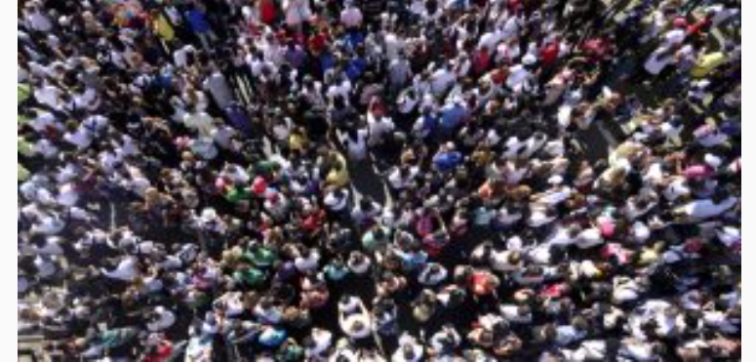
The UN predicts that by 2100 the world population will have increased by another 4 billion people. What is the main reason?
There will be more children
(age below 15)
There will be more adults
(age 15 to 74)
There will be more very old people
(age 75 and older)
Notes:
pause the video while you discuss your answer!

Slide 13
The UN predicts that by 2100 the world population will have increased by another 4 billion people. What is the main reason?
There will be more children
(age below 15)
There will be more adults
(age 15 to 74)
There will be more very old people
(age 75 and older)
Notes:
B) more adults
In their forecasts, the UN experts calculate that just 1 percent of the population increase will come from 0.37 billion more children(age 0 to 14). 69 percent from 2.5 billion more adults (age 15 to 74). And 30 percent from 1.1 billion more very old people (age 75 and older).

Slide 14
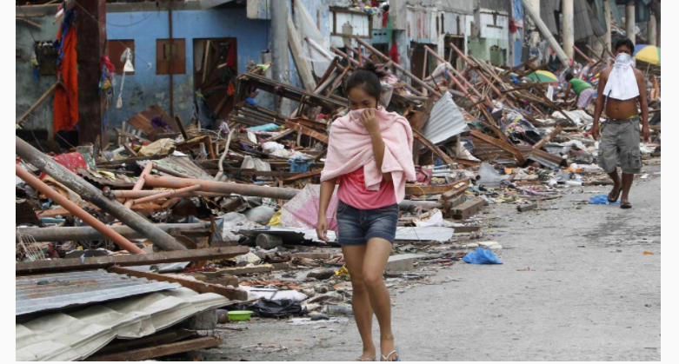
How did the number of deaths per year from natural disasters change over the last hundred years?
More than doubled
Remained about the same
Decreased to less than half
Notes:
pause the video while you discuss your answer!

Slide 15
How did the number of deaths per year from natural disasters change over the last hundred years?
More than doubled
Remained about the same
Decreased to less than half
Notes:
C) decreased to less than half
Annual deaths from natural disasters have decreased by 75 percent over the past 100 years, according to the International Disaster Database. This is including the facts that the number of people has increased by four and disasters weren’t as well documented in the past so probably resulted in even more casualties.

Slide 16

There are roughly 7 billion people in the world today. Where do they live?
1 billion in the Americas, 1 billion in Europe,
1 billion in Africa, 4 billion in Australia and Asia
1 billion in the Americas, 1 billion in Europe,
2 billion in Africa, 3 billion in Australia and Asia
2 billion in the Americas, 1 billion in Europe,
1 billion in Africa, 3 billion in Australia and Asia
Notes:
pause the video while you discuss your answer!

Slide 17
There are roughly 7 billion people in the world today. Where do they live?
1 billion in the Americas, 1 billion in Europe,
1 billion in Africa, 4 billion in Australia and Asia
1 billion in the Americas, 1 billion in Europe,
2 billion in Africa, 3 billion in Australia and Asia
2 billion in the Americas, 1 billion in Europe,
1 billion in Africa, 3 billion in Australia and Asia
Notes:
1 billion in the Americas, 1 billion in Europe, 1 billion in Africa, 4 billion in Australia and Asia

Slide 18

How many of the world’s 1-year-old children today have been vaccinated against some disease?
20%
50%
80%
Notes:
pause the video while you discuss your answer!

Slide 19
How many of the world’s 1-year-old children today have been vaccinated against some disease?
20%
50%
80%
Notes:
C) 80%
88 percent of 1-year-old children in the world today are vaccinated against some disease according to the World Health Organization.The vaccines that reached most 1-year-olds worldwide in 2016 are BCG, Diphtheria, Measles and Polio

Slide 20

Worldwide, 30-year-old men have spent 10 years in school, on average. How many years have women of the same age spent in school?
9 years
6 years
3 years
Notes:
pause the video while you discuss your answer!

Slide 21
Worldwide, 30-year-old men have spent 10 years in school, on average. How many years have women of the same age spent in school?
9 years
6 years
3 years
Notes:
9 years
The correct answer is A. Worldwide, women aged 25 to 34 have an average of 9.09 years of schooling, and men have 10.21. This is based on Health Data estimates from 188 countries. As always, there is uncertainty in these kinds of estimates, but there is no reason to assume that the difference between genders is nearly as large as what people think.

Slide 22

In 1996, tigers, giant pandas and black rhinos were all listed as endangered. How many of these three species are more critically endangered today?
Two of them
One of them
None of them
Notes:
pause the video while you discuss your answer!

Slide 23
In 1996, tigers, giant pandas and black rhinos were all listed as endangered. How many of these three species are more critically endangered today?
Two of them
One of them
None of them
Notes:
C) none of them
Key word is more- None of the three species are classified as more critically endangered today than they were in 1996. The data is based on the IUCN Red List of Threatened Species; see IUCN Red List below, with tables on the numbers of threatened species between 1996 and 2017.
The tiger was classified as Endangered in 1996, and it still is According to a statement from WWF in 2016, the number of wild tigers is increasing: “After a century of decline, tiger numbers are on the rise. At least 3,890 tigers remain in the wild, but much more work is needed to protect this species that’s still vulnerable to extinction.” the giant panda was classified as Endangered in 1996, but in 2015, its classification was changed to the less critical status of Vulnerable.The black rhino was classified as Critically Endangered and still is.

Slide 24
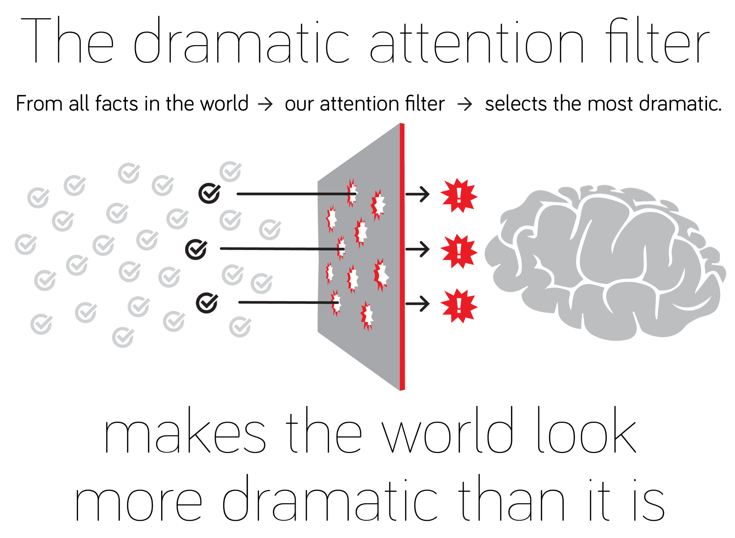
Notes:
It’s likely you scored low by picking the more negative answers- nearly everyone does, the average score is 40%, we all scored lower than expected when we did it too. Bear in mind what you have learnt from this going forward that not everything is as negative as it seems make sure you’re not making things worse by over-dramatising them.

Slide 25

It’s hard to maintain a positive outlook when it sometimes feels like you’re being bombarded with the negatives
It can also be difficult to not over-dramatise or misinterpret negative information
Notes:
It can be easy to have a negative outlook on global affairs and just life in general
You tend to be presented with more negatives than positives
In order to keep yourself healthy (and to get the facts right) it’s important to make sure you don’t see everything in a negative light

Slide 26


