Slide 1

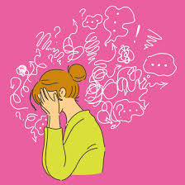
Headstrong
Week 17

Slide 2
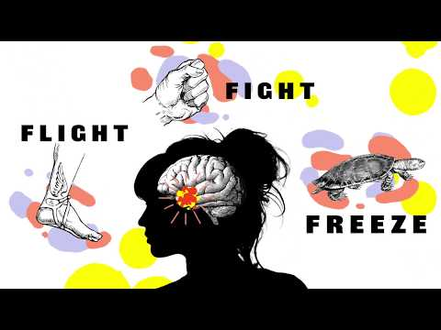
https://www.youtube.com/watch?v=rpolpKTWrp4

Slide 3
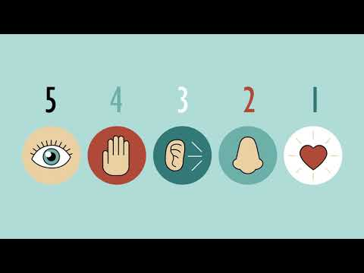
https://www.youtube.com/watch?v=30VMIEmA114

Slide 4
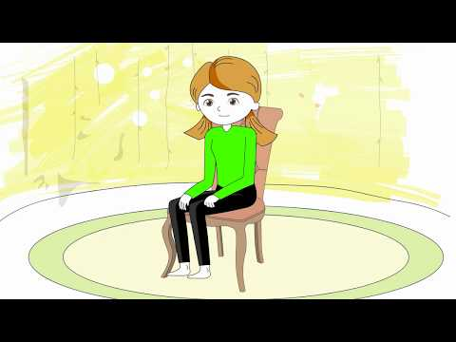
https://www.youtube.com/watch?v=ihwcw_ofuME

Slide 5

Managing anxiety
We will all feel anxious at times, but we can learn ways to make certain that this doesn’t control us.
Explain to someone at home the Freeze, Fight or Flight reaction and how this links to anxiety.
Practice either the body scan or the sensory grounding at least once more during the week - to manage anxiety we need this in our toolkit for when we feel overwhelmed. It is hard to put it into practice if you don’t practice it when you are calm.

Slide 6

https:be.com/watch?v=gicU5so_8yQ//www.youtu

