Slide 1


Headstrong
Week 22

Slide 2

The 5 ways to well-being are positive things we can do to help ourselves - this weeks challenge is focusing on GIVE.

Slide 3
Friday 25th March - Food Drive Reminder!
PLEASE DONATE FOOD AND HELP THOSE LESS FORTUNATE IN YOUR COMMUNITY. AS BEFORE CRATES WILL BE AVAILABLE IN MAIN SCHOOL, LOWER SCHOOL AND WOODSIDE FOR YOUR DONATIONS.
NON PERISHABLE ITEMS ONLY. THE ITEMS ESPECIALLY NEEDED ARE SHOWN IN RED (on the next slide) BUT ALL DONATIONS GRATEFULLY RECEIVED (ALTHOUGH THE FOODBANK HAVE REQUESTED NO PASTA AS THEY HAVE PLENTY)

Slide 4

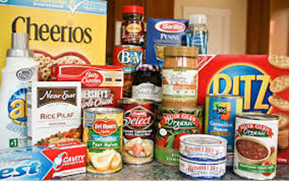
How many items can your form bring in?
Long life Fruit Juice
Tinned Tuna
Tinned Rice Puddings
Tinned Sponge Puddings
Cereal Bars (5 pack)
Tinned Meatballs/Hotdogs
Pasta Sauces
Small Childrens’ Easter Eggs

Slide 5
The challenge won’t take too long this week, so if you have time, try to complete one of the following things…
Have you completed your Ukraine flowers?
Have you submitted your International Women’s Day artwork?
Has your healthy school representative recorded all your points?
Talk to someone in your form about something you are looking forward to over the Easter break.
Listen to a song as a form and have a good sing together to start the day.
Brainstorm any topics you would like to cover in Headstrong and email them to Mrs Cole.

Slide 6


