Slide 1
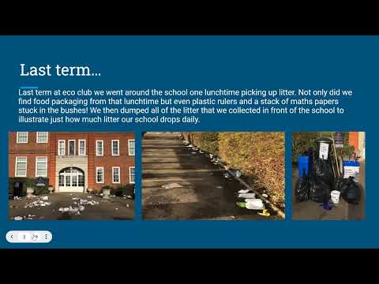

Slide 2
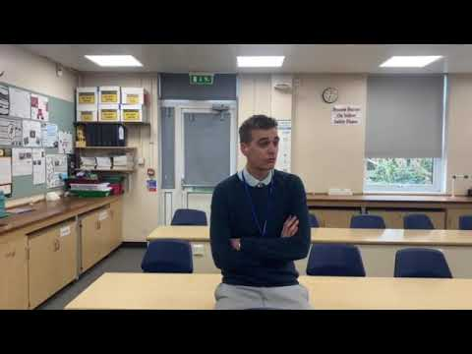

Slide 3
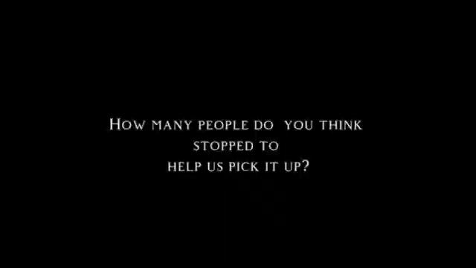

Slide 4
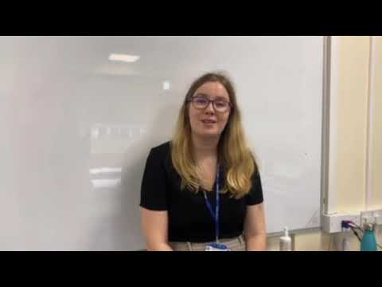

Slide 5
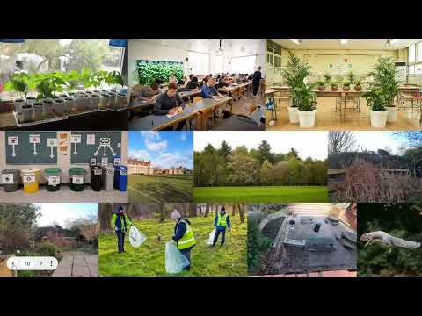

Slide 6
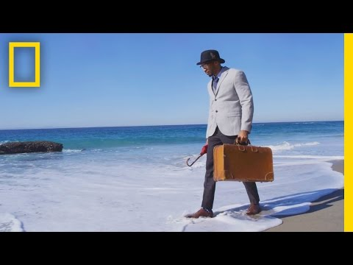

Slide 7
Weekly Challenge!
Please complete the following short Google Form which will hopefully help us understand which environmental issues are important to you, whether you think the school is doing enough and what (if anything) you might be willing to do to help.
CLICK HERE!
Tutors, please share this presentation on your form’s Google Classroom.
Many thanks!

Slide 8

Footnote. Last Friday, 1.31pm :(

