Slide 1


Week 27
Ssh…Be Quiet!

Slide 2
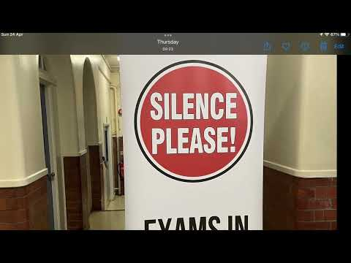

Slide 3

With that in mind…

Slide 4
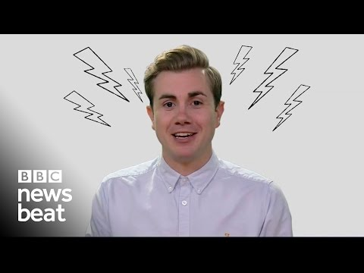

Slide 5

You have 2 challenges:
Make a pledge today as a form to remember to be quiet and considerate every time you see the exam signs.
As a form try to come up with your own top 3 tips for revision - share these together so you can start thinking about how you will prepare for the end of year exams when they start.

Slide 6


