Slide 1
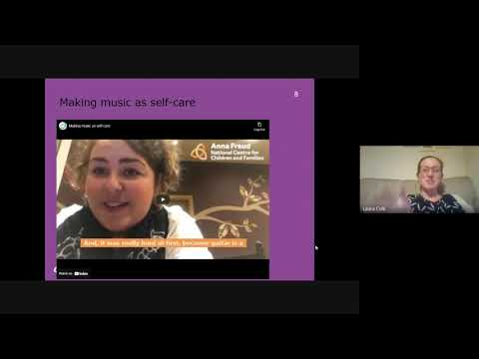

Slide 2
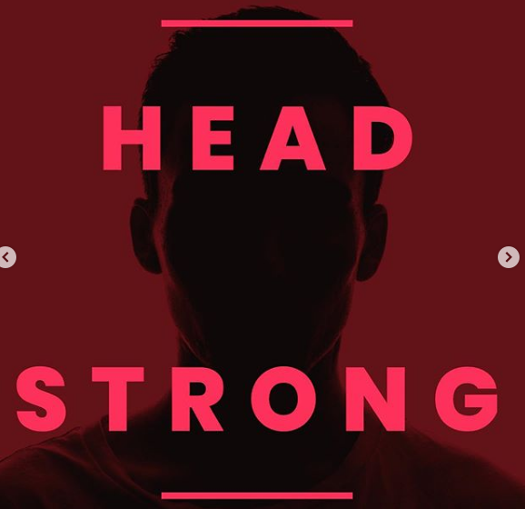
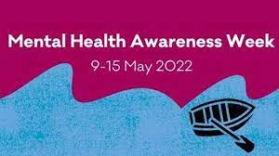
Headstrong

Slide 3


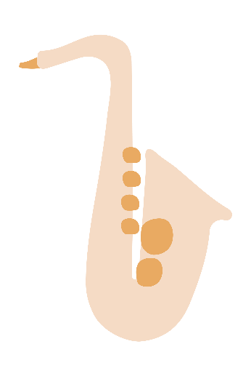

Mental Health Awareness Week
1
Looking after our mental health:
Music for self-care

Slide 4

3
What is mental health?
Mental health is about our feelings, our thinking, our emotions and our moods.
Looking after our mental health is just as important as looking after our physical health.

Slide 5
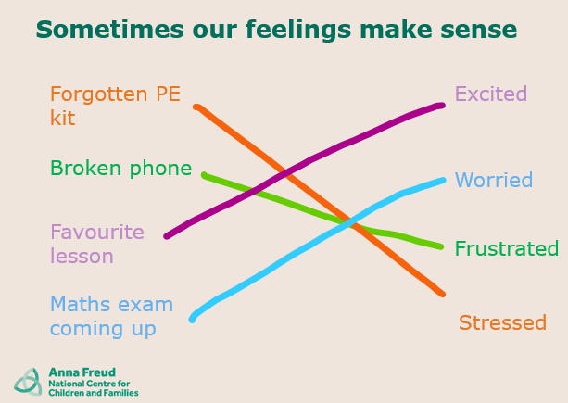

Slide 6
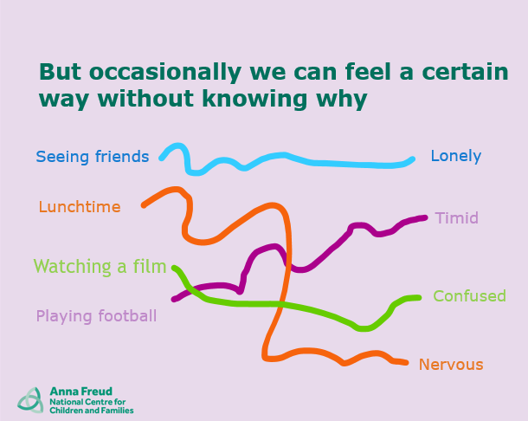

Slide 7

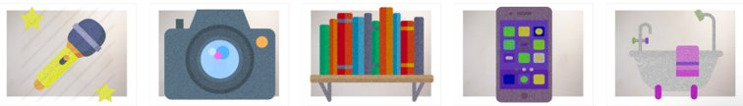
Self-care is all about what you can do to help yourself feel better or to keep yourself feeling good
It’s a way that we can look after our own mental health and wellbeing.
7

Slide 8

Where can I find support in school?
When can I get support?
Who might be able to support me?
What should I do if I have an issue?
11

Slide 9

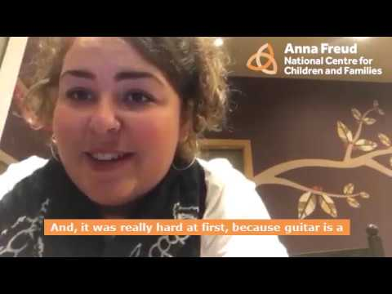
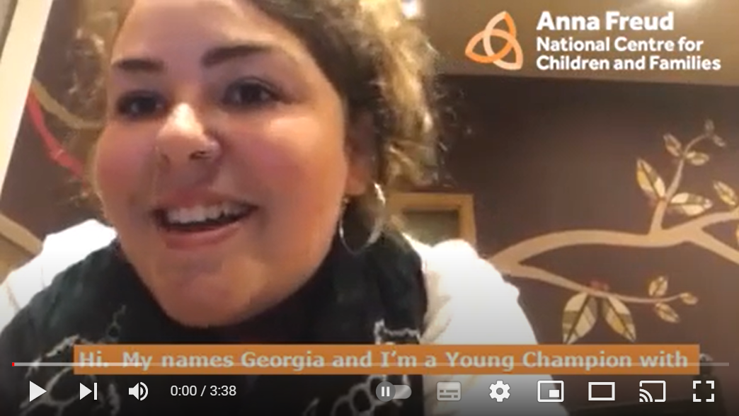
Making music as self-care
8
Watch video here

Slide 10


Discuss
9
How did learning the guitar help Georgia with her mental health?
Has learning an instrument helped anyone else with their mental wellbeing?

Slide 11
What is an important part of your self-care routine?
What are you passionate about?
10
Discuss

Slide 12

Georgia spoke about how music helped her mental health. We can’t learn an instrument in form time is morning, but listening to a favourite song or having a good sing can be really good for your mental health too.
As a form, pick a song - find it on youtube and have a listen. Bonus points if you sing along and can get your form tutor to join in!
(If you fancy a dance too, it is definitely a good way to brighten up the morning!)

