Slide 1
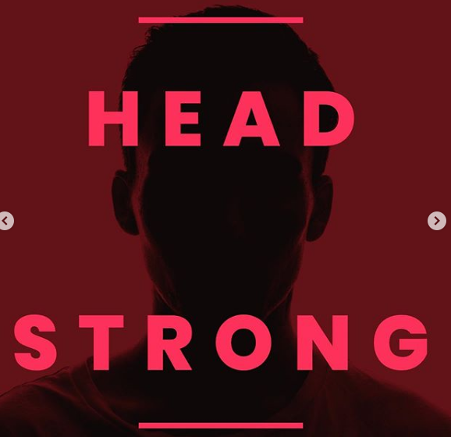
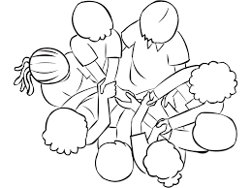
Headstrong
Week 30

Slide 2
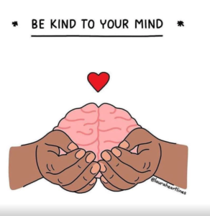
Let’s take a break from work and revision this morning…
Lots of students are sitting exams at the moment or in the next few days.
In order to perform well, we need to remember to relax too and have some fun!
Getting outside or completing physical activities can be part of this, so your challenge this week is exactly this…

Slide 3
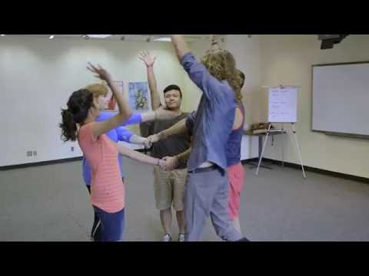

Slide 4

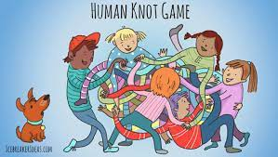
The human knot
Your challenge as a form is to give the human knot a go.
You will get points for the number of knots you manage to untie as a form.
Bonus points will be awarded for the forms which have the largest number of people in any one knot!

