Slide 1
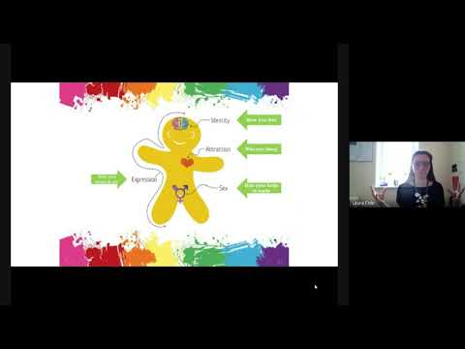

Slide 2
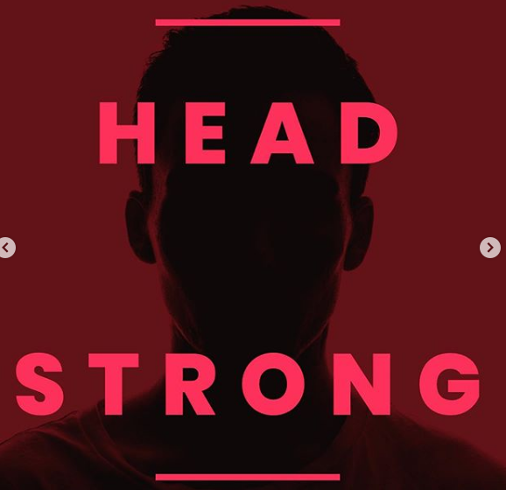

Headstrong
Week 31

Slide 3

What do these letters stand for? Why might we think about these in June in particular? Do you know any other letters that might be added?

Slide 4
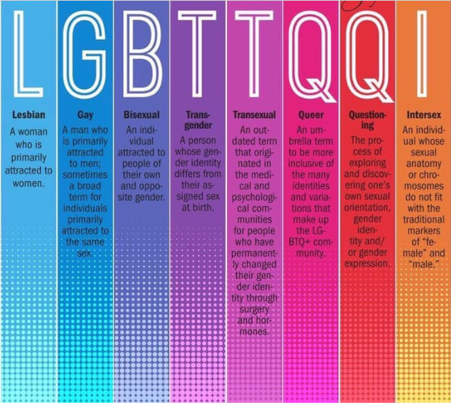


Slide 5
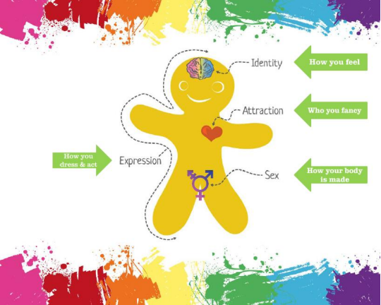

Slide 6

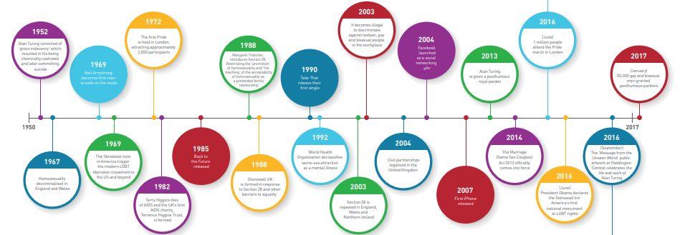
Pride History

Slide 7
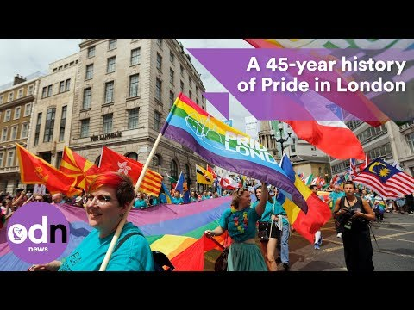

Slide 8
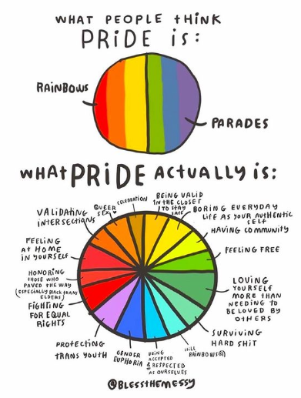


Slide 9



