Slide 1
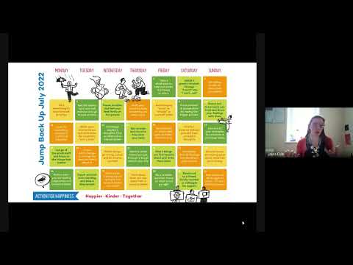

Slide 2


Headstrong
Week 34

Slide 3
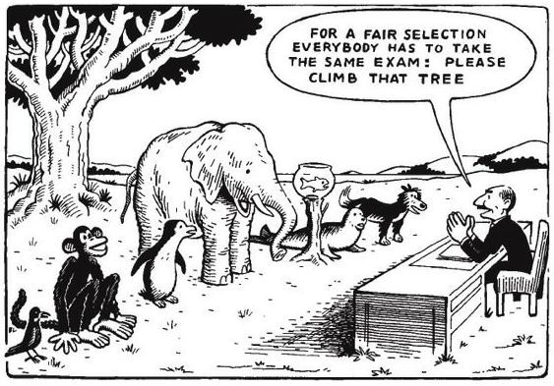

Slide 4
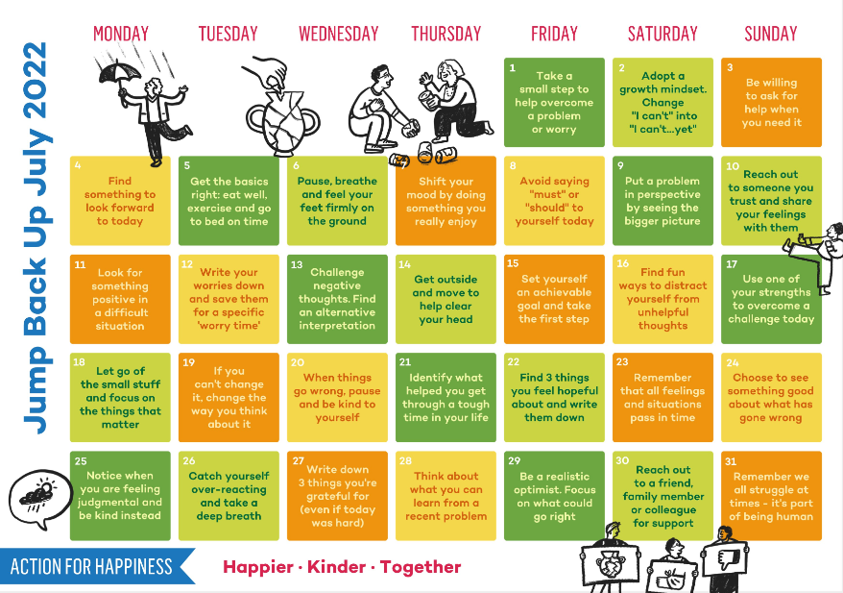

Slide 5

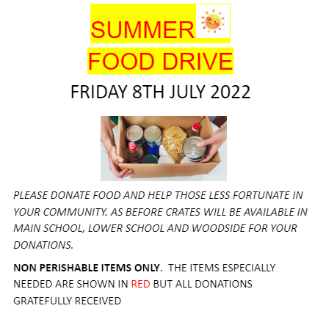
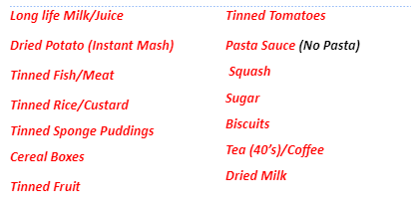
Notes:
Bring in items for the Summer Food Drive Friday 8th July Red / required items below
Long life milk / juice
Dried potato (instant mash)
Tinned Fish / Meat
Tinned Rice / Custard
Tinned sponge puddings
Cereal boxes
Tinned Fruit
Tinned tomatoes
Pasta sauce (no pasta)
Squash
Sugar
Biscuits
Tea (40’s)/Coffee
Dried Milk

Slide 6


